Slide 1
Recyclable Sorter
Trisha & Julyan

Slide 2
Table of contents
01
02
03
04
Introduction
Data collection
Choice of model
Evaluation

Slide 3
01
Introduction

Slide 4
Purpose
Differentiates between items of different materials

Slide 5


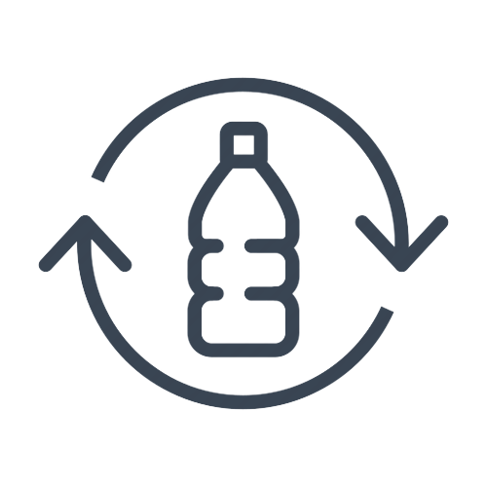

Common materials found in recyclables
Paper
Metal
Plastic
Glass
Newspapers
Cardboard boxes
Envelopes
Beverage cans
Biscuit tins
Metal cutlery
PET bottles
Plastic bags
Shampoo bottles
Food jars
Cosmetic bottles
Liquor bottles

Slide 6
02
Data

Slide 7

Where did we source our data from?
← Kaggle

Slide 8
Why Kaggle?
Open source
Access to a wide range of data

Slide 9
Challenges faced
Overfitting
OpenCV

Slide 10
03
Chosen model

Slide 11

Recyclable Sorter model

Slide 12
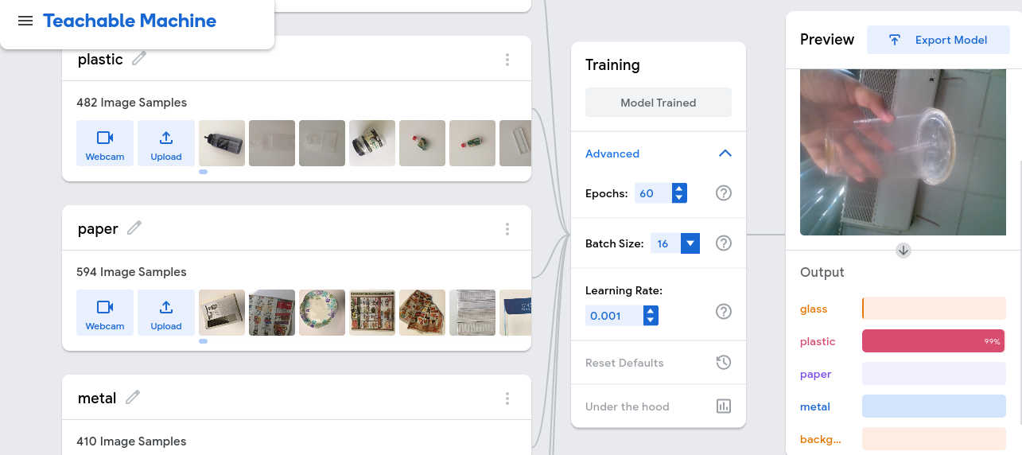

Slide 13
01
Face recognition

Slide 14
Table of contents
01
02
03
04
Introduction
Data collection
Choice of model
Evaluation

Slide 15
Face detection model

Slide 16
Evaluation

Slide 17
9h 55m 23s
333,000
386,000 km
Jupiter’s rotation period
The Sun’s mass compared to Earth’s
The distance between Earth and the Moon

Slide 18
Buyer journey map
Trigger | Review | Purchase decision | Engagement | Relationship management | Renewal
Mercury is the closest planet to the Sun and the smallest of them all | Venus has a beautiful name and is the second planet from the Sun | Earth is the third planet from the Sun and the only one that harbors life | Despite being red, Mars is actually a very cold place. It’s full of iron oxide dust | Saturn is a gas giant and has several rings. It’s composed mostly of hydrogen | Neptune is the farthest planet from the Sun. It is very far away from us

Slide 19
The B2B marketing funnel
Venus is the second planet from the Sun
Awareness
Mars is actually a very cold place
Consideration
Jupiter is the biggest planet of them all
Decision
Neptune is far away from Earth
Retention

Slide 20
98,300,000
Big numbers catch your audience’s attention

Slide 21
Conclusion

Slide 22
Optimize your website
Three improvements
Image compression
XML sitemap
Mercury is the closest planet to the Sun
Mercury is the closest planet to the Sun
Page load speed
Mercury is the closest planet to the Sun

Slide 23
Let’s use some percentages
25%
50%
75%
Mercury
Venus
Mars
Mercury is the closest planet to the Sun and the smallest one of them all
Venus has a beautiful name and is the second planet from the Sun
Despite being red, Mars is actually a cold place. It’s full of iron oxide dust

Slide 24

Computer mockup
You can replace the image on the screen with your own work. Just right-click on it and select “Replace image”

Slide 25
Create an effective B2B SEO strategy
01
Buyer personas
02
Keyword research
03
Mercury is the closest planet to the Sun
Relevant content
04
Neptune is the eighth planet from the Sun
Relevant content
Earth is the only planet known to harbor life
Jupiter was named after a Roman god

Slide 26

Tablet mockup
You can replace the image on the screen with your own work. Just right-click on it and select “Replace image”

Slide 27
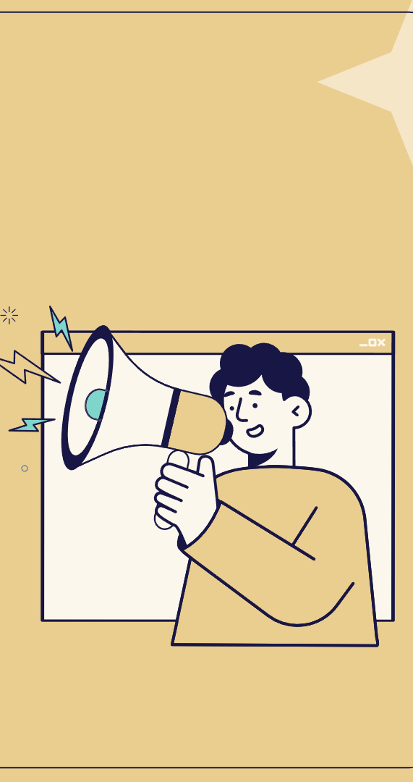
Phone mockup
You can replace the image on the screen with your own work. Just right-click on it and select “Replace image”

Slide 28
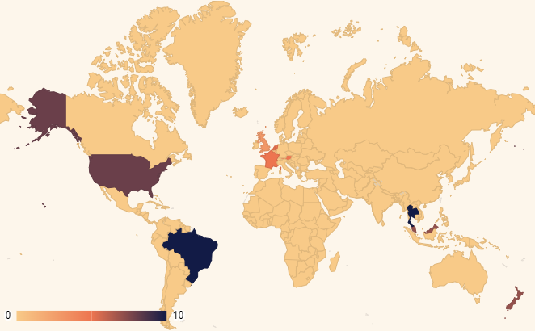
This is a map
Mars
Mars is very cold
Mercury
Mercury is small
Venus
Venus is very hot
Follow the link in the map to modify its data and then paste the new one here. For more info, click here

Slide 29
A timeline always works well
Step 1
Step 2
Step 3
Step 4
Venus is a hot planet
Mercury is very small
It's made of basalt
Jupiter is a gas giant
Step 5
Step 6
Step 7
Step 8
Saturn has rings
The Sun is a star
Earth harbors life
Neptune is a giant

Slide 30
Infographics are useful
Mars
01
02
Venus
Jupiter
03
04
Saturn
Solar System
Earth
05
06
The Moon
Mercury
07
08
Pluto

Slide 31
Use tables to represent data
 | Team A | Team B | Team C | Team D | Team E | Team F
Mercury | XX | XX | XX | XX | XX | XX
Mars | XX | XX | XX | XX | XX | XX
Saturn | XX | XX | XX | XX | XX | XX
Venus | XX | XX | XX | XX | XX | XX
Jupiter | XX | XX | XX | XX | XX | XX
Earth | XX | XX | XX | XX | XX | XX
Pluto | XX | XX | XX | XX | XX | XX

Slide 32
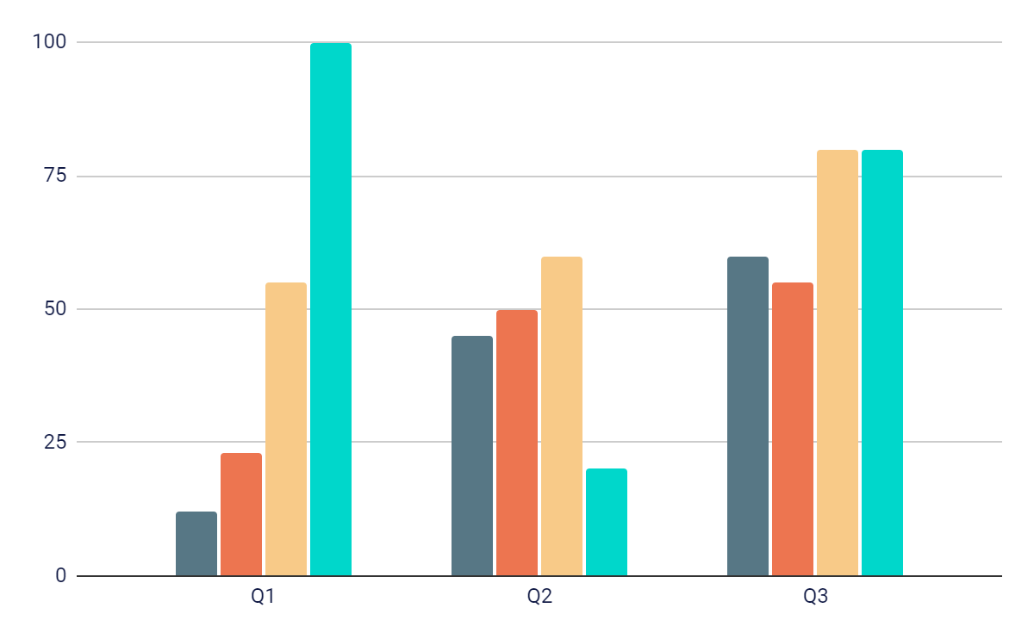
You can use this graph
Team 1
Team 2
Team 3
Team 4
Follow the link in the graph to modify its data and then paste the new one here. For more info, click here

Slide 33
Different elements in B2B SEO
Choose your strategy
01
02
03
04
Technical SEO
Content SEO
On-page SEO
Off-page SEO
Venus is the second planet from the Sun
Mars is actually a very cold place
It's the biggest planet of them all
Neptune is far away from Earth

Slide 34


Our team
Sofia Hill
Timmy Jimmy
You can speak a bit about this person here
You can speak a bit about this person here

Slide 35
Thanks!

